Slide 1
Graphics Level 1
Jin Chengyu

Slide 2
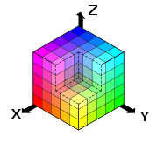
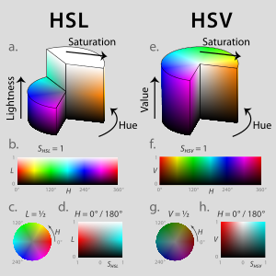
Color mode
RGB Mode
Red(R), Green(G), Blue(B)
HSL, HSV
Hue(H)
Saturation(S)
Lightness(L)
Value(V)
CMYK Mode
Cyan(C), Magenta(M), Yellow(Y), Black(K)

Slide 3
Color Mode
CMYK Mode
Cyan(C), Magenta(M), Yellow(Y), Black(K)

Slide 4
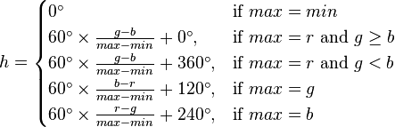

Color Mode
RGB to HSL
h ∈ [0, 360）,s, l ∈ [0,1]

Slide 5

Color Mode
RGB to HSV
h ∈ [0, 360）

Slide 6



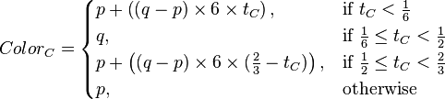

Color Mode
HSL to RGB
(R = G = B = L, if s = 0)

Slide 7


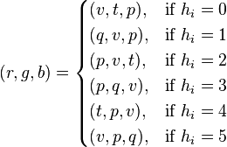
Color Mode
HSV to RGB

Slide 8
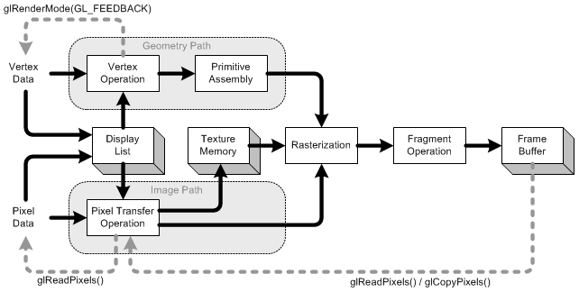
Render Pipeline
Fixed-Function Pipeline

Slide 9
Render Pipeline
Display List
Vertex buffer and Index buffer
Performance improvement
Vertex operation
Vertex and normal coordinates transformation
Lighting is also calculated here

Slide 10
Render Pipeline
Primitive Assembly
All primitives (point, lines and polygon) are transformed by projection matrix and clipped by view volume clipping planes
Perspective division and viewport transform
Culling test
Pixel Transfer Operation
Scale, bias, mapping, clamping

Slide 11
Render Pipeline
Texture Memory
All textures are loaded into texture memory
Rasterization
Geometric and pixel data converted into fragments
Fragment contains: color, depth, point size etc, all the data necessary to generate a pixel in the frame buffer
Fragment Operation
Convert fragments to pixels onto frame buffer
Fog, blending, dithering, logical operation and mask

Slide 12
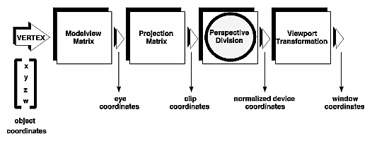
Coordination Transform
Coordinates System
Modeling transformation
View transformation
Projection transformation
Viewport transformation

Slide 13
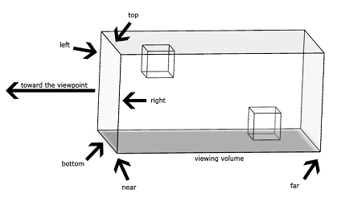
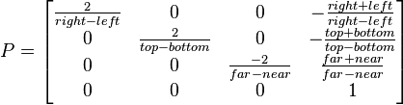
Coordination Transform
Projection transformation
Orthographic transformation
Ortographic Matrix

Slide 14
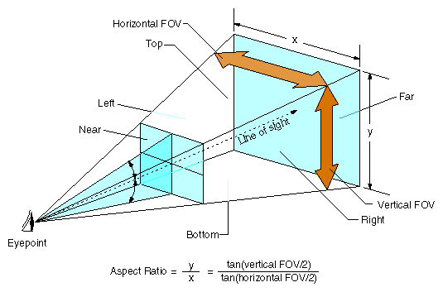
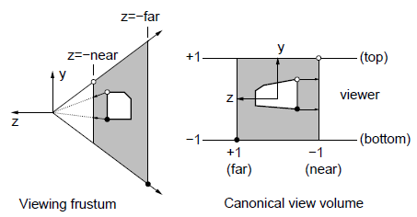
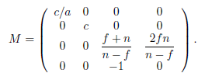
Coordination Transform
Perspective transformation
Perspective Matrix
c = cot(fovy/2), a = aspect ratio = w/h

Slide 15
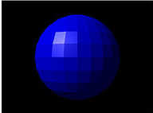
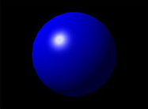
Illumination model
Flat shading
Gouraud and Phong shading

Slide 16
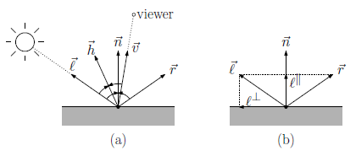

Illumination model
Normal vector n: Normal of the surface
View vector v: Points towards viewer
Light vector l: Points towards light source
Reflection vector r: Reflection of the light vector
Halfway vector h:

Slide 17
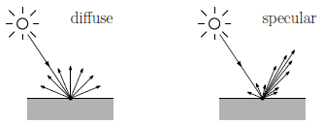
Illumination model
Diffuse and specular
Diffuse
Specular

Slide 18

Illumination model
Final equation
Emissive
Ambient
Diffuse
Specular

Slide 19
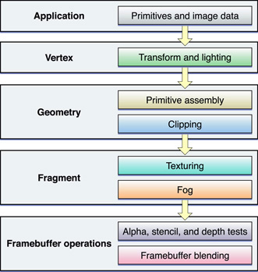
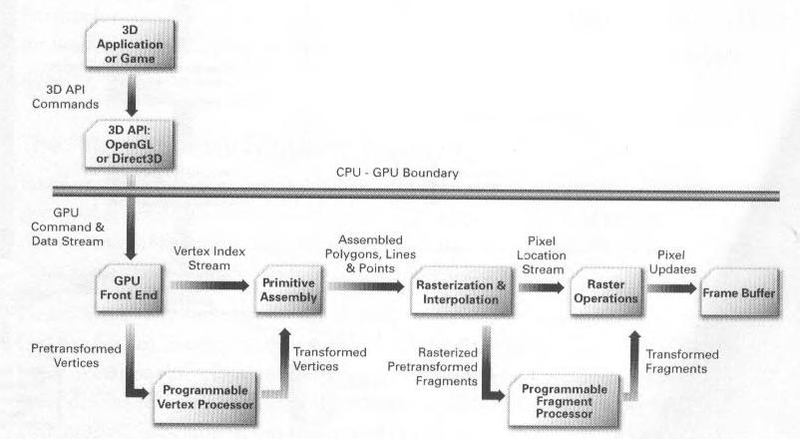
Render Pipeline
Programmable Pipeline

Slide 20
Shader Language
What is shader?
A program written in special shading language which is compiled by CPU and uploaded directly into graphics hardware.
Advantages of shader
More control to the rendering operations
Easy algorithm format. (Complex blocks of configuration calls in fixed-functon pipeline)
Do complex algorithm in single pass
Switch between different shaders is easy

Slide 21
Shader Language
Existing Shader Languages
Assembly (Different APIs, GPUs)
OpenGL Shading Language (GLSL) - OpenGL
High Level Shading Language(HLSL) – Direct3D
C for Graphic (Cg) – NVIDIA

Slide 22
Shader Language
Vertex shader
Pixel(fragment) shader
Geometry shader

Slide 23
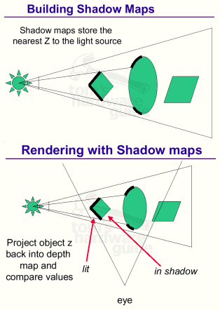
Shadow
Shadow Map
Theory
A point is lit if there is nothing blocking a straight line path between the light and the point

Slide 24
Shadow
Shadow Map
Draw the scene from the light’s point of view and save the depth buffer
Render the entire scene from camera’s point of view with dim light (To light the scene slightly)
Render the entire scene from camera’s point of view with normal light. In this pass need depth comparison.

Slide 25
Shadow
Shadow Map
Advantages
No extra processing of scene/geometry is required.
Do not need stencil buffer
Disadvantages
Single texture is required to hole shadow info for each light
Aliasing problem (Especially when using small texture)
Precision (Z-fighting)
Working for spot light (Need more times for point light)

Slide 26
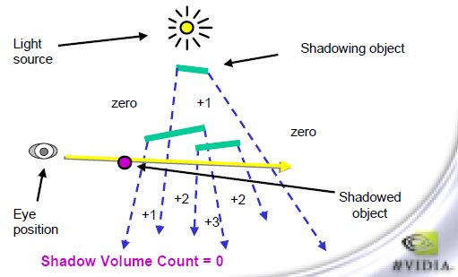
Shadow
Shadow Volume
Solution 1. Z-pass
Rendering entire scene, get depth map
Disable Z-write render shadow volume front face, if depth test pass, stencil value increase 1
Render shadow volume back face, if depth test pass, stencil value decrease 1
Render scene normally, if stencil value is not zero, use shadow color here

Slide 27
Shadow
Shadow Volume
Solution 2. Z-fail
Rendering entire scene, get depth map
Disable Z-write render shadow volume back face, if depth test pass, stencil value increase 1
Render shadow volume front face, if depth test pass, stencil value decrease 1
Render scene normally, if stencil value is not zero, use shadow color here

Slide 28
Shadow
Shadow Volume
Advantages
Precision (Avoid aliasing problem)
Working with dynamic light
Disadvantages
Extra vertex/polygon cost

Slide 29
Post-Process
What is Post-Process?
The scene is firstly rendered to a buffer in the memory
Pixel shaders apply post-processing filters to the image buffer
Display the filtered result on the screen

Slide 30
Post-Process
Blur
Motion Blur
Bloom
HDR
Depth of Field

Slide 31



Deferred Shading
Deferred vs Forward
Single-pass, multi-light
Multi-pass, multi-light
Deferred shading

Slide 32
Deferred Shading
Advantage
-VERY easy and simple to make, and can be made fairly fast. -Very tight boundaries on what pixels the light volumes affect (i.e. not many pixels, if any, are wasted). -Fairly geometric complexity-agnostic because you're only doing a single draw. -Low amount of state changes -One-time generation of reasonably complex perpixel data, e.g. calculation of normals for normal mapping, Fresnel specular coefficients, anisotropic filtering. -Scales very nicely as number of lights increases

Slide 33
Deferred Shading
Disadvantage
No hardware antialiasing.
High initial cost of G-Buffer generation due to the large amount of data that must be generated.
Fairly high memory cost, especially at higher resolutions
Very fillrate/memory-bandwidth intensive
Has problem with optical object

